Slide 1
UPPER SIXTH ARTS
GEOGRAPHY
Further Study 1
Agricultural Development and Change in Cameroon
Notes:
Good morning, class, and welcome to our geography lesson. I am your geography teacher, Mr Kamdem. Today we are starting Further Study 1: Agricultural Development and Change in Cameroon.

Slide 2
CLASS INFO
Class, Chapter and Duration
Class | Upper Sixth Arts
Chapter | Module 6: Understanding and managing the dynamics of economic activities across the world in general and Cameroon in particular
Duration | 2 periods (2 × 50 minutes)
Notes:
This lesson is for Upper Sixth Arts. It belongs to Module 6: Understanding and managing the dynamics of economic activities across the world in general and Cameroon in particular. We shall need 2 periods to cover it.

Slide 3
IDENTIFICATION
Lesson Identification
Topic | Geography of Cameroon
Sub-topic | Agricultural Systems and Patterns of Cameroon
Lesson | Further Study 1: Agricultural Development and Change in Cameroon
Notions / Concepts | Peasant farming, plantation, livestock, CDC, SODECOTON, second-generation agriculture.
Syllabus focus | Characteristics and importance of agriculture; peasant, plantation and livestock systems and their factors; impacts; problems and solutions; changes since independence.
Competence | Learners are able to describe the agricultural systems of Cameroon and explain their problems and changes.
Notes:
Our topic is Geography of Cameroon, and the sub-topic is Agricultural Systems and Patterns of Cameroon. The key notions we shall use today are: peasant farming, plantation, livestock, CDC, SODECOTON, second-generation agriculture. At the end, you should be able to do this: learners are able to describe the agricultural systems of Cameroon and explain their problems and changes.

Slide 4

HOMEWORK CORRECTION
Correction of the Homework
Question (Lesson 10: Impacts of Agriculture on the Environment):
List farming practices in your area that harm or protect the environment.
Notes:
Before we start the new lesson, let us correct the homework I gave you at the end of Lesson 10: Impacts of Agriculture on the Environment. The question was: List farming practices in your area that harm or protect the environment. Take out your exercise books.

Slide 5
HOMEWORK CORRECTION
Correction: Possible Answer
Harmful practices: bush burning, cultivating on steep slopes without terraces, overgrazing. Protective practices: using manure, planting trees, contour ridges, crop rotation.
Notes:
Here is a good answer. Harmful practices: bush burning, cultivating on steep slopes without terraces, overgrazing. Protective practices: using manure, planting trees, contour ridges, crop rotation. Compare it with your own answer and correct your work in red.

Slide 6
LESSON PLAN
Lesson Plan
Correction of the homework
Objectives and recall
Real-life situation and action to take
Learning activities
Board summary
Evaluation, remediation and homework
Notes:
Here is the plan of our lesson today. First, we shall correct the homework. Then we shall look at the objectives and recall what you already know. After that, we shall study a situation from real life and the action to take, and do the learning activities. Finally, we shall copy the board summary, do the evaluation and the remediation, and I will give you the homework.

Slide 7
OBJECTIVES
Objectives
By the end of this lesson, you should be able to:
Describe the characteristics and systems of agriculture in Cameroon.
Explain the factors and impacts of these systems.
Notes:
Take your time to copy this part; we will continue together.

Slide 8
OBJECTIVES
Objectives (continued)
Explain the problems, solutions and changes since independence.
Notes:
By the end of this lesson, you should be able to do three things. Number 1: describe the characteristics and systems of agriculture in Cameroon. Number 2: explain the factors and impacts of these systems. Number 3: explain the problems, solutions and changes since independence.

Slide 9
PREVIOUS KNOWLEDGE
Previous Knowledge
Cameroon grows cocoa, coffee, cotton and bananas.
Farming systems are intensive or extensive.
Notes:
Let us first remember what you already know. Cameroon grows cocoa, coffee, cotton and bananas. Farming systems are intensive or extensive. Keep this in mind, because we shall build on it today.

Slide 10
REAL-LIFE SITUATION
Situation in Real Life
In the South-West, the CDC runs huge plantations of banana, palm and rubber. Nearby, peasant farmers grow cassava and cocoa on small plots with hoes. In the Adamawa, herders keep cattle on open grassland.
Notes:
Listen carefully to this situation from real life. In the South-West, the CDC runs huge plantations of banana, palm and rubber. Nearby, peasant farmers grow cassava and cocoa on small plots with hoes. In the Adamawa, herders keep cattle on open grassland. Think about it, because I am going to ask you some questions.

Slide 11
REAL-LIFE SITUATION
Situation: Question 1
What is the problem in the situation?
Notes:
Question 1: What is the problem in the situation? Think for a moment, then raise your hand to answer.

Slide 12
REAL-LIFE SITUATION
Answer
Cameroon has very different farming systems.
Notes:
Good. Cameroon has very different farming systems.

Slide 13
REAL-LIFE SITUATION
Situation: Question 2
Which system uses large estates and many workers?
Notes:
Question 2: Which system uses large estates and many workers? Think for a moment, then raise your hand to answer.

Slide 14
REAL-LIFE SITUATION
Answer
The plantation system.
Notes:
Good. The plantation system.

Slide 15
REAL-LIFE SITUATION
Situation: Question 3
Which system is most common?
Notes:
Question 3: Which system is most common? Think for a moment, then raise your hand to answer.

Slide 16
REAL-LIFE SITUATION
Possible Answer
Peasant (small-scale) farming.
Notes:
Good. Peasant (small-scale) farming.

Slide 17
ACTION TO TAKE
Action to Take
Modernise agriculture in Cameroon while supporting small farmers.
Notes:
From this situation, the action we are working towards in this lesson is the following: modernise agriculture in Cameroon while supporting small farmers.

Slide 18
JUSTIFICATION
Justification of the Lesson
This further study helps us to understand the farming of our own country.
Notes:
Why is this lesson important for you? This further study helps us to understand the farming of our own country.

Slide 19
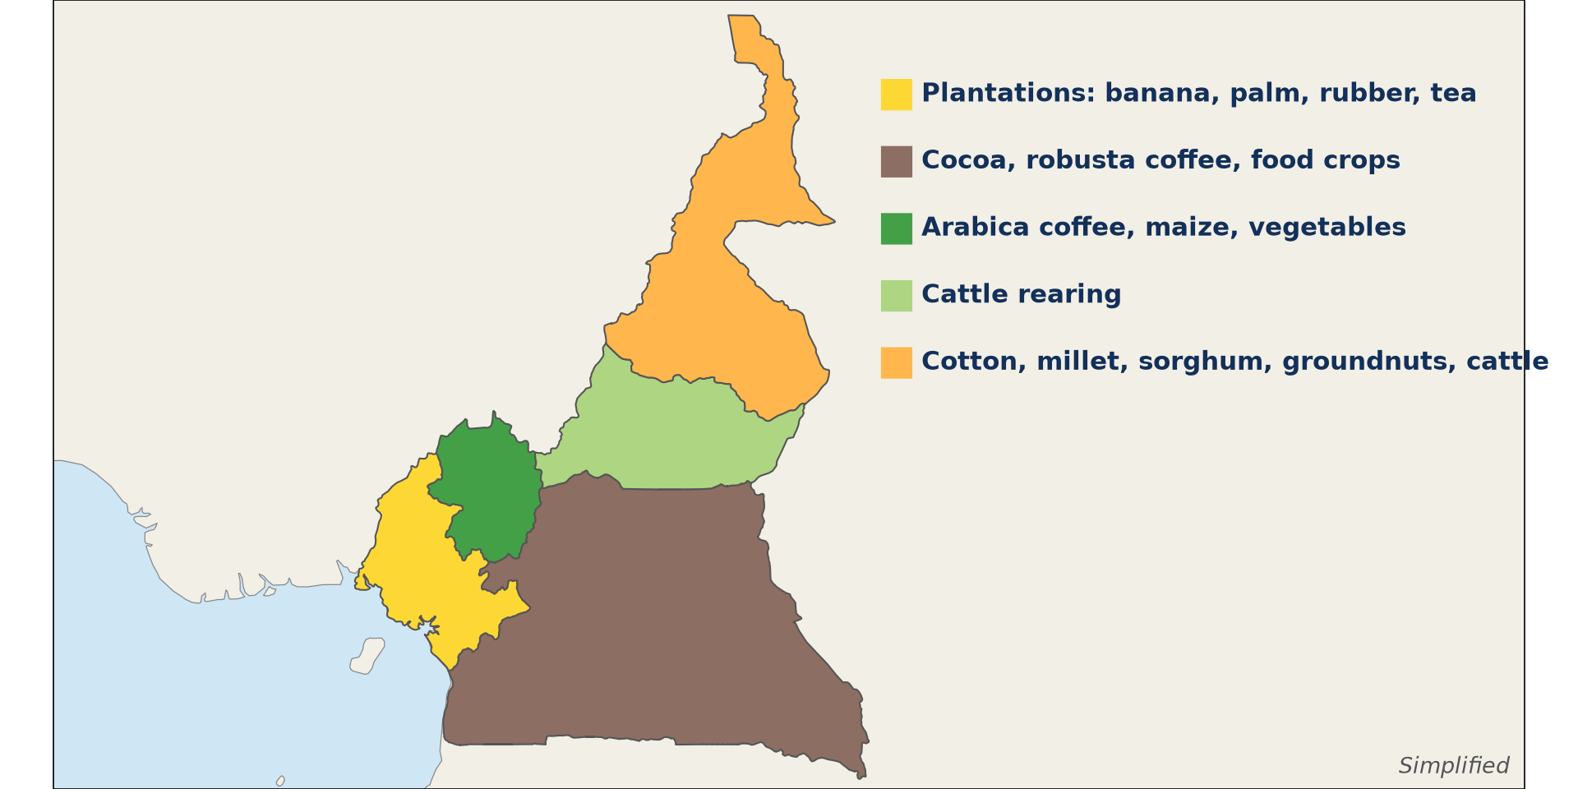
2. SPATIAL DISTRIBUTION
Activity 1
Main farming regions of Cameroon (simplified).
Notes:
Activity 1. Look carefully at this diagram: main farming regions of Cameroon (simplified). Observe every detail before I ask the question.

Slide 20
2. SPATIAL DISTRIBUTION
Activity 1: Question
Name the main crop of the North and the main crop of the Centre and South.
Notes:
Here is the question for Activity 1: Name the main crop of the North and the main crop of the Centre and South. Take one minute to think and write your answer in your rough notebook.

Slide 21
2. SPATIAL DISTRIBUTION
Activity 1: Answer
North: cotton. Centre and South: cocoa.
Notes:
Let us check the answer together. North: cotton. Centre and South: cocoa.

Slide 22

2. A) PEASANT CROP PRODUCTION
Activity 2
A small family farm.
Notes:
Activity 2. Look carefully at this picture: a small family farm. Observe every detail before I ask the question.

Slide 23
2. A) PEASANT CROP PRODUCTION
Activity 2: Question
Give three characteristics of peasant farming.
Notes:
Here is the question for Activity 2: Give three characteristics of peasant farming. Take one minute to think and write your answer in your rough notebook.

Slide 24
2. A) PEASANT CROP PRODUCTION
Activity 2: Answer
Small plots, family labour, simple tools, mixed food and cash crops.
Notes:
Let us check the answer together. Small plots, family labour, simple tools, mixed food and cash crops.

Slide 25
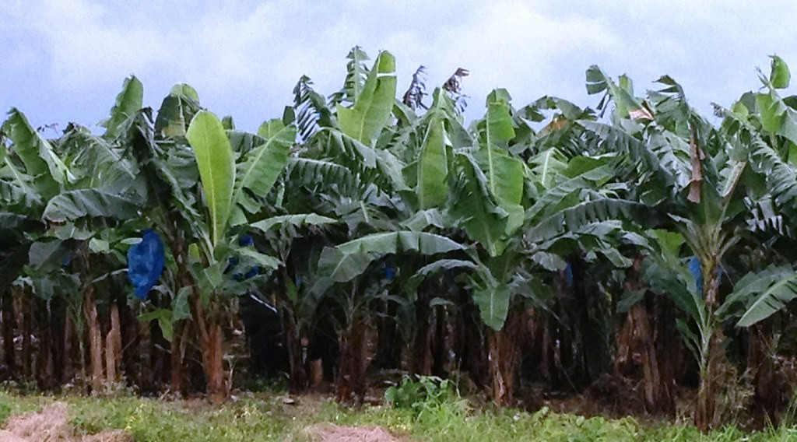
2. B) PLANTATION SYSTEMS
Activity 3
A banana plantation.
Notes:
Activity 3. Look carefully at this picture: a banana plantation. Observe every detail before I ask the question.

Slide 26
2. B) PLANTATION SYSTEMS
Activity 3: Question
Give three characteristics of plantation agriculture.
Notes:
Here is the question for Activity 3: Give three characteristics of plantation agriculture. Take one minute to think and write your answer in your rough notebook.

Slide 27
2. B) PLANTATION SYSTEMS
Activity 3: Answer
Large estates, one crop, many paid workers, much capital, for export.
Notes:
Let us check the answer together. Large estates, one crop, many paid workers, much capital, for export.

Slide 28

2. C) LIVESTOCK FARMING
Activity 4
Cattle.
Notes:
Activity 4. Look carefully at this picture: cattle. Observe every detail before I ask the question.

Slide 29
2. C) LIVESTOCK FARMING
Activity 4: Question
Where are most cattle reared in Cameroon? Why?
Notes:
Here is the question for Activity 4: Where are most cattle reared in Cameroon? Why? Take one minute to think and write your answer in your rough notebook.

Slide 30
2. C) LIVESTOCK FARMING
Activity 4: Answer
Adamawa and the north: grasslands and fewer tsetse flies.
Notes:
Let us check the answer together. Adamawa and the north: grasslands and fewer tsetse flies.

Slide 31
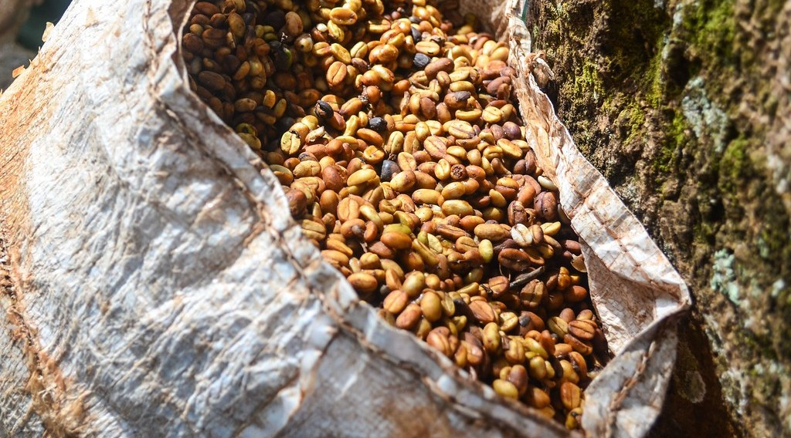
3. PROBLEMS AND CHANGES
Activity 5
Harvested coffee beans.
Notes:
Activity 5. Look carefully at this picture: harvested coffee beans. Observe every detail before I ask the question.

Slide 32
3. PROBLEMS AND CHANGES
Activity 5: Question
Give two problems of agriculture and one change since independence.
Notes:
Here is the question for Activity 5: Give two problems of agriculture and one change since independence. Take one minute to think and write your answer in your rough notebook.

Slide 33
3. PROBLEMS AND CHANGES
Activity 5: Answer
Problems: poor roads, low prices. Change: agro-industrial companies and second-generation agriculture.
Notes:
Let us check the answer together. Problems: poor roads, low prices. Change: agro-industrial companies and second-generation agriculture.

Slide 34
BOARD SUMMARY
Board Summary
Topic: Geography of Cameroon
Sub-topic: Agricultural Systems and Patterns of Cameroon
Further Study 1: Agricultural Development and Change in Cameroon
Notes:
Now we are going to copy the board summary. Write the title and the headings neatly in your notebooks. I will give you enough time for each slide, so do not rush.

Slide 35
BOARD SUMMARY
1. General Characteristics of Agriculture in Cameroon
Agriculture in Cameroon has the following characteristics:
Types and importance: Most farming is small-scale peasant farming, with some large plantations and livestock ranches. It employs most rural people and provides food and exports.
Notes:
Let us copy General Characteristics of Agriculture in Cameroon. Agriculture in Cameroon has the following characteristics. On this slide we have Types and importance. Write each point on a new line, with the key term first, and explain it in your own words when we revise. When you finish, we go to the next slide.

Slide 36
BOARD SUMMARY
1. General Characteristics of Agriculture in Cameroon (continued)
Productivity: Yields are low because of simple tools, few inputs and poor roads. Cameroon is nevertheless a food basket for Central Africa.
Notes:
We continue with General Characteristics of Agriculture in Cameroon. On this slide we have Productivity. Write each point on a new line, with the key term first, and explain it in your own words when we revise.

Slide 37
BOARD SUMMARY
1. General Characteristics of Agriculture in Cameroon
Illustration: agricultural regions of Cameroon
Notes:
Now draw this illustration in your notebook: agricultural regions of Cameroon. Give it a title and label it clearly.

Slide 38
BOARD SUMMARY
2. Systems of Agriculture
The main systems and their characteristics are:
Peasant crop production: Small family farms (1–3 ha) with hoes and family labour grow food crops and some cash crops. Examples are cocoa in the Centre and South, coffee in the West and cotton in the North.
Notes:
Let us copy Systems of Agriculture. The main systems and their characteristics are. On this slide we have Peasant crop production. Write each point on a new line, with the key term first, and explain it in your own words when we revise. When you finish, we go to the next slide.

Slide 39
BOARD SUMMARY
2. Systems of Agriculture (continued)
Modern plantations: Large estates owned by companies (CDC, SOCAPALM, PHP) grow one crop with paid workers, machines and fertilisers. They produce bananas, rubber, oil palm and tea for export.
Notes:
We continue with Systems of Agriculture. On this slide we have Modern plantations. Write each point on a new line, with the key term first, and explain it in your own words when we revise. When you finish, we go to the next slide.

Slide 40
BOARD SUMMARY
2. Systems of Agriculture (continued)
Livestock farming: Traditional nomadic and semi-nomadic herding of zebu cattle dominates the Adamawa and North. Modern ranches (SODEPA) and poultry farms near towns are growing.
Notes:
We continue with Systems of Agriculture. On this slide we have Livestock farming. Write each point on a new line, with the key term first, and explain it in your own words when we revise.

Slide 41
BOARD SUMMARY
3. Factors, Problems and Changes
Agriculture is influenced and has changed as follows:
Factors of distribution: Climate, soils, relief, markets, colonial history and government policy explain where each system is found. The humid south grows tree crops, the dry north cereals and cotton.
Notes:
Let us copy Factors, Problems and Changes. Agriculture is influenced and has changed as follows. On this slide we have Factors of distribution. Write each point on a new line, with the key term first, and explain it in your own words when we revise. When you finish, we go to the next slide.

Slide 42
BOARD SUMMARY
3. Factors, Problems and Changes (continued)
Problems: Low prices, poor roads, old farmers, pests and lack of credit reduce production. Land conflicts and insecurity also affect some regions.
Notes:
We continue with Factors, Problems and Changes. On this slide we have Problems. Write each point on a new line, with the key term first, and explain it in your own words when we revise. When you finish, we go to the next slide.

Slide 43
BOARD SUMMARY
3. Factors, Problems and Changes (continued)
Changes since independence: Development agencies (SODECOTON, SEMRY, SODECAO), agro-industrial complexes and the liberalisation of markets have changed farming. Young farmers now use improved seeds and new crops.
Notes:
We continue with Factors, Problems and Changes. On this slide we have Changes since independence. Write each point on a new line, with the key term first, and explain it in your own words when we revise.

Slide 44
BOARD SUMMARY
4. Impacts of the Agricultural Systems
The systems have the following impacts:
On the economy and communities: Agriculture provides employment, export revenue and food, and raises living standards where prices are good. Plantations create jobs and towns but may take land from villagers.
Notes:
Let us copy Impacts of the Agricultural Systems. The systems have the following impacts. On this slide we have On the economy and communities. Write each point on a new line, with the key term first, and explain it in your own words when we revise. When you finish, we go to the next slide.

Slide 45
BOARD SUMMARY
4. Impacts of the Agricultural Systems (continued)
On the environment: Shifting cultivation, plantations and overgrazing cause deforestation, soil erosion and loss of biodiversity. Chemicals from plantations can pollute rivers.
Notes:
We continue with Impacts of the Agricultural Systems. On this slide we have On the environment. Write each point on a new line, with the key term first, and explain it in your own words when we revise.

Slide 46
FORMATIVE EVALUATION
Evaluation 1
Compare peasant farming and plantation agriculture in Cameroon.
Notes:
Now let us check what you have understood. Question 1: Compare peasant farming and plantation agriculture in Cameroon. Answer in your exercise book.

Slide 47
FORMATIVE EVALUATION
Expected Answer
Peasant: small plots, family labour, food crops. Plantation: large estates, paid labour, export crops.
Notes:
The expected answer is: peasant: small plots, family labour, food crops. Plantation: large estates, paid labour, export crops. If you got it right, well done.

Slide 48
FORMATIVE EVALUATION
Evaluation 2
Give three problems of agriculture in Cameroon.
Notes:
Now let us check what you have understood. Question 2: Give three problems of agriculture in Cameroon. Answer in your exercise book.

Slide 49
FORMATIVE EVALUATION
Expected Answer
Poor roads, low prices, pests (also drought, credit, storage).
Notes:
The expected answer is: poor roads, low prices, pests (also drought, credit, storage). If you got it right, well done.

Slide 50
REMEDIATION
Remediation
Fill in the blanks:
The CDC runs ______ in the South-West.
Cotton is grown in the ______.
Most cattle are in the ______.
Notes:
For those who need more practice, fill in the blanks in your exercise book. The answers are: number 1, plantations; number 2, North; number 3, Adamawa.

Slide 51
HOMEWORK
Homework
Draw the farming map of Cameroon and write one crop per region.
Notes:
For your homework: Draw the farming map of Cameroon and write one crop per region. We shall correct it at the beginning of our next lesson.

Slide 52
NEXT LESSON
Next Lesson
Our next lesson will be on:
Lesson 11: Energy Resources
Notes:
Our next lesson will be on Lesson 11: Energy Resources. Thank you for your attention, and see you next time.

Slide 53
BILINGUAL GAME
Bilingual Game (Jeu Bilingue)
English | Français
Plantation | La plantation
Peasant | Le paysan
Livestock | L'élevage
Cooperative | La coopérative
Cocoa | Le cacao
Cotton | Le coton
Notes:
Let us play the bilingual game. I say a word in English, and you give me the French word. Then we do the reverse.

Slide 54
LOGBOOK
Official Logbook (1/2)
Module / Topic | Geography of Cameroon
Lesson Title | Further Study 1: Agricultural Development and Change in Cameroon
Expected Learning Outcomes | Describe the characteristics and systems of agriculture in Cameroon. Explain the factors and impacts of these systems. Explain the problems, solutions and changes since independence.
Competence | Learners are able to describe the agricultural systems of Cameroon and explain their problems and changes.
Notes:
I record this information in the official logbook of the class after the lesson.

Slide 55
LOGBOOK
Official Logbook (2/2)
Matter Taught | General Characteristics of Agriculture in Cameroon; Systems of Agriculture; Factors, Problems and Changes; Impacts of the Agricultural Systems.
Evaluation | Formative evaluation and remediation exercise.
Homework | Draw the farming map of Cameroon and write one crop per region.
Enrolment / Present / Absent | ____ / ____ / ____
Achievement | To be completed after the lesson.
Notes:
I complete the second page of the logbook: the matter taught, the evaluation, the homework and the attendance.

Slide 56
TEACHER'S NOTE
Teacher's Note
Timing: Homework correction, plan, objectives 8 min | Recall, situation, action 10 min | 5 activities 30 min | Board summary (copying) 30 min | Evaluation, remediation 10 min | Homework, next lesson 5 min | Logbook 7 min
Without the projector (Activity 1): draw the map.
Without the projector (Activity 2): describe a family farm.
Without the projector (Activity 3): mention CDC and PHP.
Without the projector (Activity 4): discuss transhumance.
Without the projector (Activity 5): discuss problems.
Notes:
This slide is for me, the teacher: it gives the timing of the lesson and what to do if the projector is not available.

Slide 57
REFERENCES
References
National Geography Syllabus, MINESEC/IGE/IP-SS, 2019 — Module 6 (Economic Geography).
Photo, Activity 2: “Cameroon - UN Women's Gender Road Project” by UN Women Gallery, CC BY-NC-ND 2.0, via Flickr (https://www.flickr.com/photos/51431730@N04/46914753474)
Photo, Activity 3: “Banana Plantation” by AfricaTravelAssociation, CC BY 2.0, via Flickr (https://www.flickr.com/photos/65134942@N06/8164706151)
Photo, Activity 4: “Fulani cattle breed of West Africa” by International Livestock Research Institute, CC BY-NC-SA 2.0, via Flickr (https://www.flickr.com/photos/7155605@N03/48125675226)
Photo, Activity 5: “Harvesting coffee, Cameroon” by jbdodane, CC BY-NC 2.0, via Flickr (https://www.flickr.com/photos/27998473@N02/11590251453)
Diagrams and animations: drawn for this lesson (Geography Department).
Notes:
These are the references and picture credits used to prepare this lesson.

